Slide 1
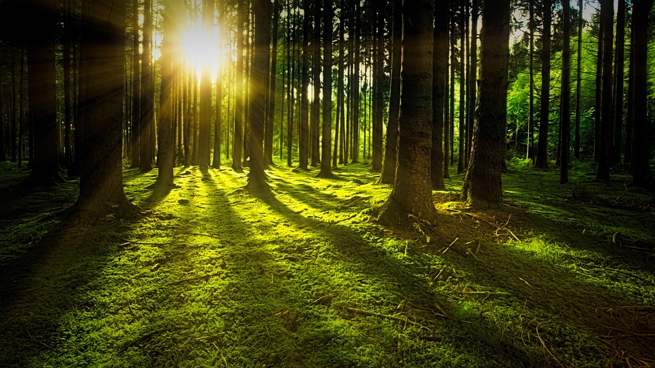
Final Group Project - DBAS3017
Shay Gillis, Jack Fierlbeck, and Bradley Horne
December 13, 2022

Slide 2
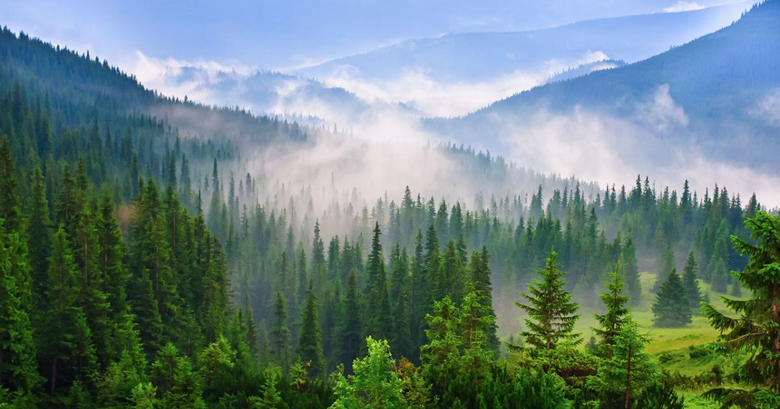
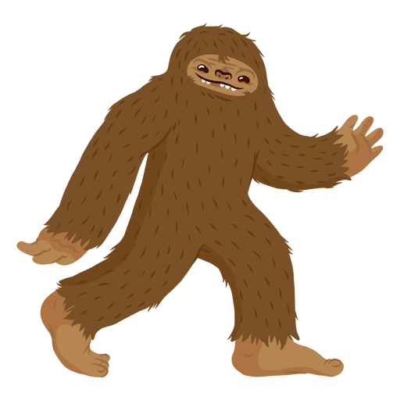
Introduction
What is our topic for our Data Visualization Final Project?
bigfoot png - Bing images
This Photo by Unknown author is licensed under CC BY-NC-ND.

Slide 3
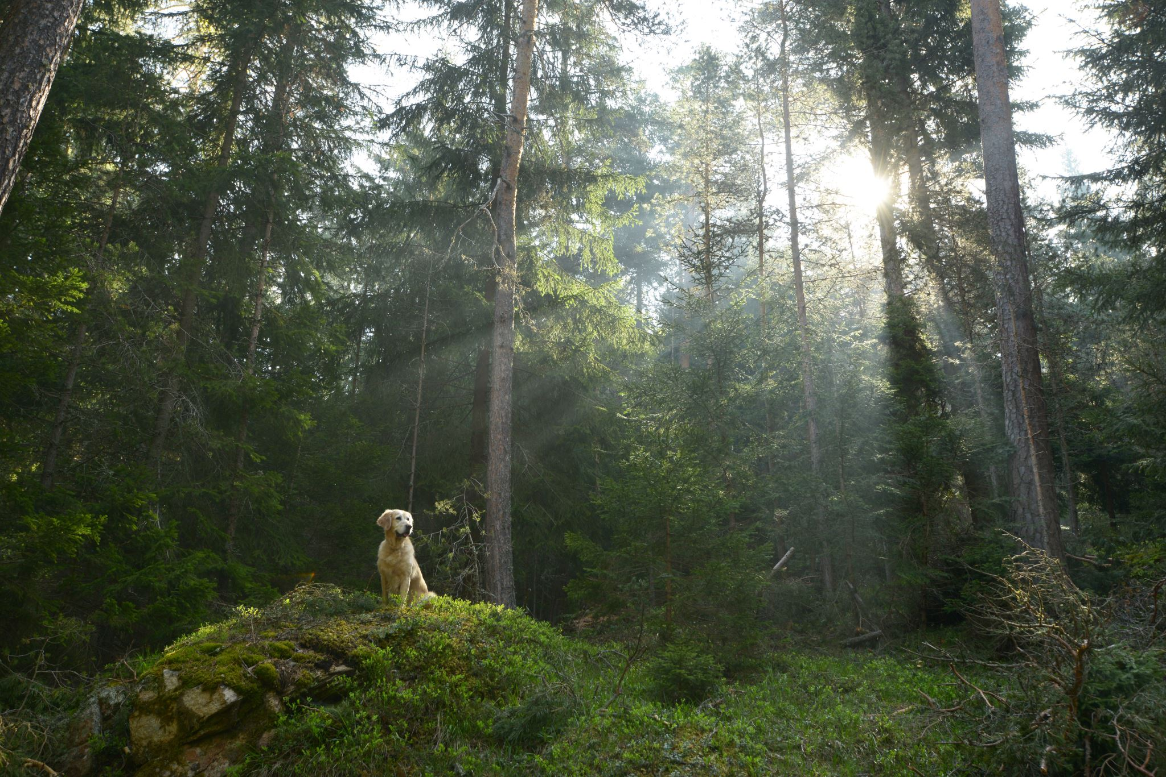
What do you already know about Bigfoot?

Slide 4

You may be wondering: Haven’t sightings gone down since the creation of smartphones?
https://public.flourish.studio/visualisation/12147994/

Slide 5

Insights gained from the Sightings vs Smartphones Graph
He is aware of human evolution
Becoming more calculated on how he travels
Less cellphones being sold caused a rise in sightings back in 2020 during the pandemic

Slide 6
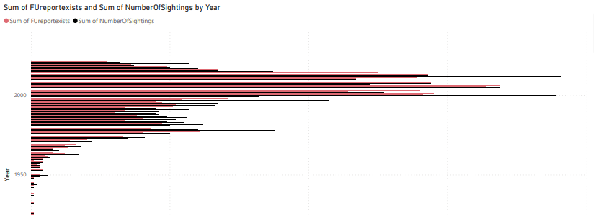
Follow up reports done compared to documented sightings?

Slide 7
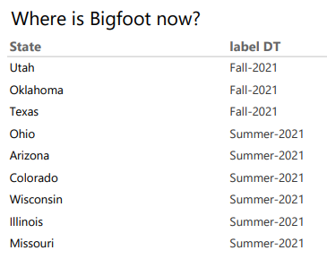

Slide 8

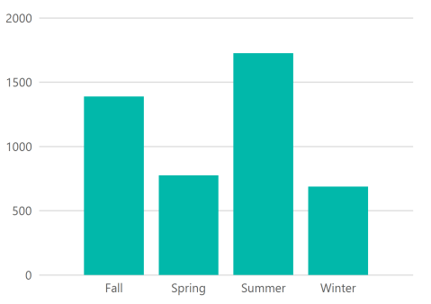
What Season does Bigfoot enjoy the most?

Slide 9
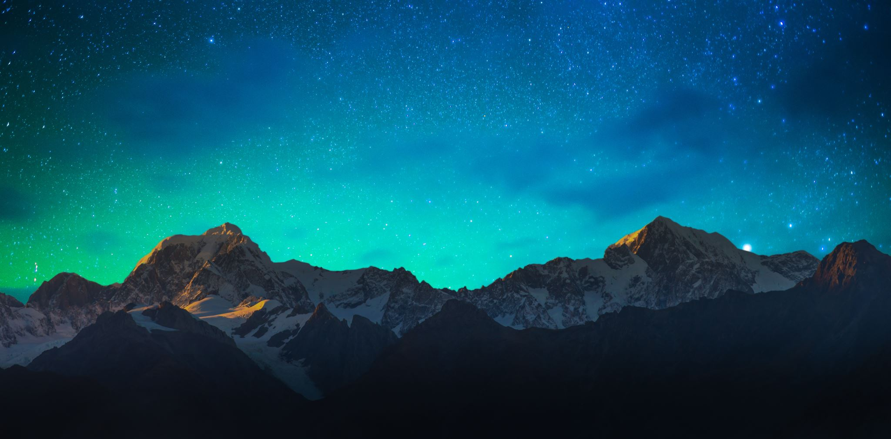
Insights Gained from Summer being Bigfoots favourite season
Our theory: He is also the yeti in the winter when he molts his winter coat, similar to the snow shoe hare.
Stay tuned next semester…

Slide 10
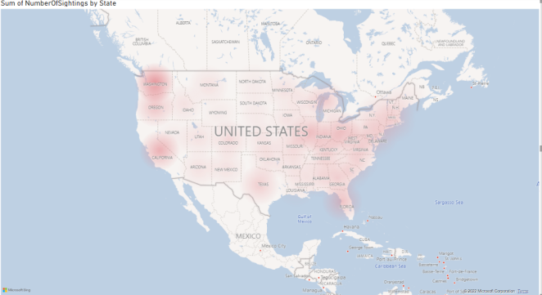
Where has Bigfoot been?

Slide 11
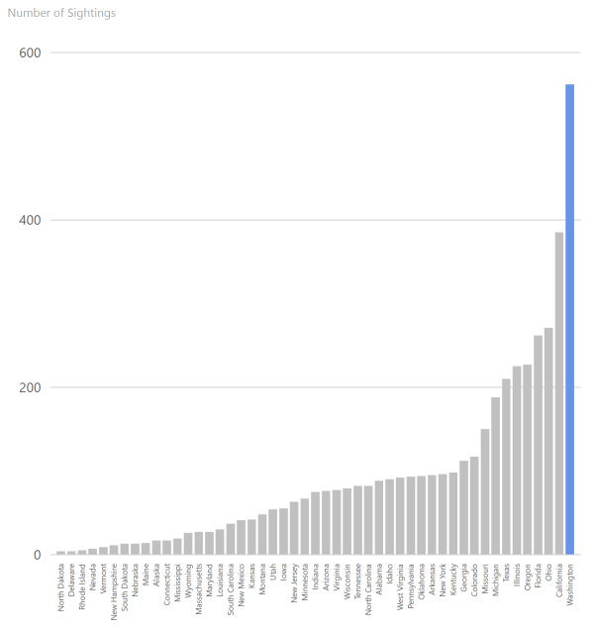
Bigfoot wants to be president

Slide 12
Bigfoot is a Greek God
There is a report in our data stating “Mt. Olympus Incident” which means, he has been to Mount Olympus. Multiple witnesses attested to this.

Slide 13

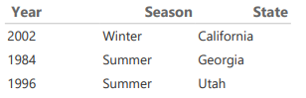
Bigfoot (The Greek Olympian) loves the Olympics
The Olympics were first started in honour of the Greek Olympians. Bigfoot attends the Olympics as it is an event held in his honor.
olympics symbol png - Bing images

Slide 14
Conclusions
Bigfoot is a fifth dimensional being who has become sneakier as smartphones have been introduced.
He has ignored mid southern states due to the desert zone, recently he has been visiting this area to gain votes in his Presidential campaign.
Theorized Yeti, as he is mostly spotted in the Summer.
Bigfoot is a Greek God Olympian who pays respect to his background by attending the Olympics when they are held in The USA.

